Slide 1
Introduction to Distribution Systems
ECpE Department
Dr. Zhaoyu Wang
1113 Coover Hall, Ames, IA
wzy@iastate.edu

Slide 2
Introduction to Energy Distribution Systems
Acknowledgement:
The slides are developed based in part on Electric Power and Energy Distribution Systems, Models, Methods and Applications, Subrahmanyan S. Venkata, Anil Pahwa, IEEE Press & Wiley, 2022
ECpE Department

Slide 3
Epilogue
While the basic principles for distribution of electricity are the same throughout the world, there are some differences between North America and the rest of the world with respect to topology and terminology. Some aspects of these differences are highlighted in Table 1.1.
Table 1.1 Common terminologies
North America | Rest of the world
Distribution systems | Distribution networks
Primary distribution | Medium-voltage, high tension
Secondary distribution | Low-voltage, low tension
Consumption: kWh | Units
Topology: radial tree structure | Radial with primary and/or secondary selective
Primary feeder protection: reclosers, fuses | Circuit breakers​
ECpE Department

Slide 4
The Electric Power System
Electric power systems have three main building blocks: generation, transmission, and distribution. In terms of capital expended, generation systems have approximately 40%, transmission systems have 20%, and distribution systems have 40% of the total. It is the last block and subsystem, which is closest to the consumers, that is the main focus of this textbook. Table 1.2 shows comparison of transmission and distribution systems based on various characteristics.
Table 1.2 Characteristics of distribution and transmission systems
Characteristics | Distribution | Transmission
Topology | Radial | Network or loop
Power | 100MVA or below | Bulk (100–1000MVA)
Voltage | <69 kV class | >120 kV class
No. of phases | Both 1 and 3 | Only 3
Load | Distributed | Concentrated
Unbalance | 20–30% | 5%​
No. of components | 10 times more | 10 times less
Capital outlay | 40% | 20%
ECpE Department

Slide 5
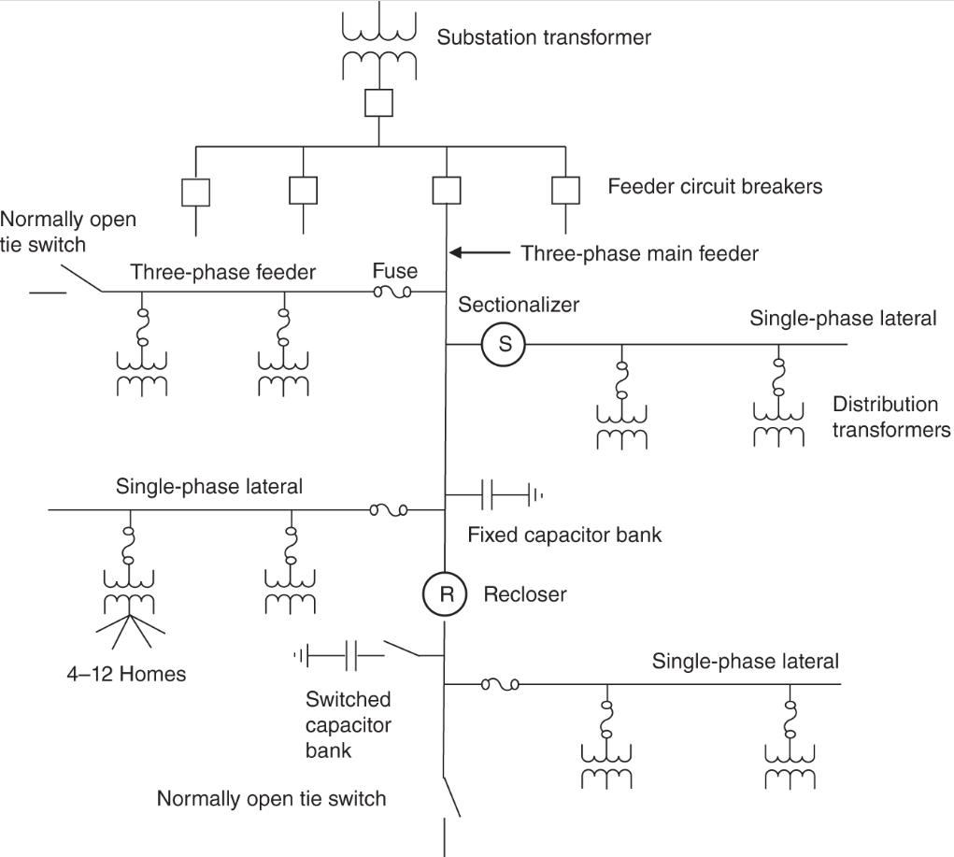
The Electric Power System
Figure 1.1 shows the layout of a typical distribution system.
The starting point for a distribution system is a distribution substation that steps down the power flowing through it from a transmission (or a subtransmission) level, say 115 kV, to a primary distribution level between 4.16 and 34.5 kV level.
The power-handling capability of a distribution substation usually varies from 5 to 25MVA.
Figure 1.1 Typical distribution system layout.
ECpE Department

Slide 6
The Electric Power System
A substation may feed two to off from the primary feeders. Depending on the nature of the load, the power is further stepped down to a secondary distribution level of 600V and less via distribution transformers.
The secondary lines feed residential loads, whereas the commercial and industrial loads are predominantly three phase in structure and may be fed directly from the primary level, depending on the connected load and power.
Most of the distribution systems around the world have overhead feeders due to cost considerations, but underground feeders have become popular due to aesthetics and higher reliability.
ECpE Department

Slide 7
Distribution System Devices
Distribution systems have a substantial number of devices, all the way from the substation to the service entrance at customer locations. The devices include transformers, switchgear, compensating devices, protection equipment, and control and monitoring devices. In this chapter, we explore these devices.
Transformers;
Switchgear;
Compensating devices;
Protection equipment;
Control and monitoring devices;
ECpE Department

Slide 8
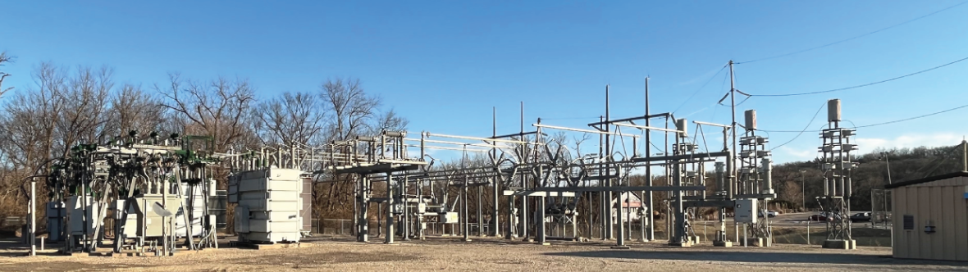
1. Substation Devices
Distribution substations are the link between the transmission system and the distribution system. Figures 1.2 and 1.3 show a distribution substation. The right-hand side of Figure 1.2 shows the 115-kV side including the incoming feeder, switching equipment, and busbars. The left-hand side of this figure shows the 12.47-kV side. A power transformer to step down the voltage is in the middle of the figure.
Figure 1.2 A 115-kV to 12.47-kV step-down distribution substation.
ECpE Department

Slide 9
1. Substation Devices
Figure 1.3 shows an enlarged view of the 12.47-kV side. Substations are typically located on the periphery of cities, but they can also be inside the cities. Sometimes the distribution substation can be part of a large transmission substation.
Figure 1.3 The 12.47-kV side of the substation showing the transformer, circuit breakers, and the rest of the equipment.
ECpE Department

Slide 10
1. Substation Devices
Distribution substations can have air- or gas-insulated equipment. Modern substations are typically gas insulated because gas reduces the size of equipment and provides additional advantages.
Sulfur hexafluoride (SF₆) has been used for substation equipment for many years. However, there are some environmental concerns associated with SF₆, which is prompting scientists to look for alternatives.
ECpE Department

Slide 11
1.1 Power Transformers
Power transformers are large transformers that receive power from the transmission system and reduce the voltage for distribution of power to consumers.
These transformers have multiple power ratings, such as 15/20/25 MVA OA/FA/FOA. The rating implies that the transformer will handle up to 15MVA with cooling provided by convective flow of oil through fins (OA), up to 20MVA with additional cooling provided by fans circulating air through fins (FA), and up to 25MVA with cooling aided by forced air as well as forced oil circulation (FOA).
ECpE Department

Slide 12
1.1 Power Transformers
These transformers typically have a load tap changer (LTC) on the secondary side to change the low-voltage side voltage up or down, depending on the load on the system.
ECpE Department

Slide 13
1.2 Switchgear
Switchgear includes all the devices that are used for opening or closing an electrical path. The most important of them is the circuit breaker, which is designed to open under fault conditions.
A circuit breaker can have air, oil, vacuum, or gas as the media.
Modern circuit breakers at high voltages are SF6 based, but most of the circuit breakers in the 15-kV class use vacuum-based interruption mechanism.
ECpE Department

Slide 14
1.2 Switchgear
Load break switches are designed to interrupt a circuit, but their capacity is limited to the maximum expected load on the circuit. They cannot interrupt a circuit under fault conditions.
Disconnect switches are purely manual devices that are used to isolate a circuit or component that has already been deenergized.
ECpE Department

Slide 15
1.3 Compensating Device
Compensating devices are used to adjust the voltage or reactive power flow.
The Regulator is like an autotransformer, which can change the output voltage by moving the tap up or down.
Capacitors provide reactive power. They can be fixed or switched. Switch capacitors are switched on to provide reactive power in response to voltage, reactive power flow, or temperature, or they can have a fixed time-based switching schedule.
ECpE Department

Slide 16
1.3 Compensating Device
Similar to capacitors, reactors can be installed in substations to absorb reactive power. Usually, reactors are not used in distribution substations, but they are sometimes used in transmission substations to compensate for the reactive power of high-voltage transmission lines under light load conditions.
ECpE Department

Slide 17
1.4 Protection Equipment
These are the equipment that respond to abnormal conditions, such as high current due to faults and high voltage caused by circuit switching or lightning.
Inverse time overcurrent and instantaneous relays are the most common types of relays deployed in distribution systems. They monitor the current flowing on the distribution feeders emanating from the substation and send trip signals to associated circuit breakers to trip if the current exceeds the threshold values.
High-voltage fuses are sometimes used on the high-voltage side of power transformers to protect them from faults.
ECpE Department

Slide 18
1.4 Protection Equipment
Other protective equipment include surge arresters for limiting voltage on equipment by discharging or bypassing surge current created by switching or lightning. In addition, the substations have static wires, which are at the top of the poles bringing an overhead transmission line into the substation or an overhead distribution line going out of the substation. These wires protect the substation equipment during lightning storms by diverting the lightning surges to the ground.
ECpE Department

Slide 19
1.5 Control and Monitoring Devices
These devices include current transformers (CTs) that reduce the current flowing on the lines to lower values for meters and relays. Similarly, voltage transformers (VTs) or potential transformers (PTs) reduce the high voltage to a lower value for metering and protection.
Traditional voltage transformers use the inductive principle to reduce the voltage, but capacitive principle can also be used for reductive voltage. The devices that use this principle are called capacitive voltage transformers (CVTs).
ECpE Department

Slide 20
1.5 Control and Monitoring Devices
Substations also have various transducers to measure different quantities such as ambient temperature, oil temperatures of transformers, and dissolved gases in transformer oil.
Since modern substations substantially integrate cyber technology, they have computers and communication links. Microwave, fiber optics, and radio are some of the options for communications. In addition, the substations have remote terminal units (RTUs), which collect information and convey this information to the supervisory control and data acquisition (SCADA) system in the control room through the communication link.
ECpE Department

Slide 21
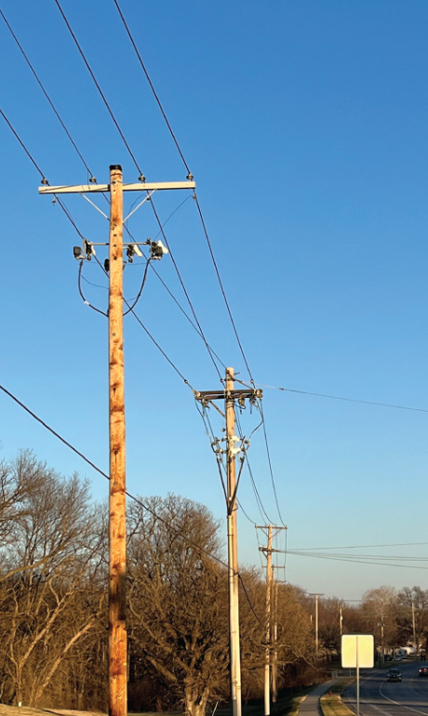
2. Primary System Components
The primary system consists of feeders that emanate from the substation and go all the way to the distribution transformers.
Figure 1.5 shows an example of an overhead primary distribution feeder along a city street. These feeders can have different configurations and conductor types. They also have different associated devices. In this section, we present a brief overview of these devices.
Figure 1.5 A 12.47-kV primary feeder.
ECpE Department

Slide 22
2.1 Feeders and Laterals
Feeders and laterals can be overhead or underground. Overhead feeders have bare conductors mounted on poles.
These conductors can be copper, aluminum, or aluminum conductor steel reinforced (ACSR). ACSR conductors are the most used bare wires for overhead distribution feeders.
ECpE Department

Slide 23
2.1 Feeders and Laterals
Underground feeders use insulated cables with copper or aluminum conductors and are insulated with ethylene propylene rubber (EPR) or cross-linked polyethylene (XLPE) polymeric insulation. A third option for feeders are the tree wires, which are copper or aluminum conductors coated with insulation for overhead feeders. They are used in areas with dense vegetation with high likelihood of contacts with trees.
ECpE Department

Slide 24
2.2 Switches
Primary feeders, which are mainly three phase, have different types of switches installed on them to provide operating flexibility.
Manual switches are installed to isolate a part of the feeder for maintenance. They can only operate on a feeder that is deenergized.
ECpE Department

Slide 25
2.2 Switches
Sectionalizing switches or sectionalizers are devices that isolate parts of a feeder under fault conditions. They do not have fault-clearing capabilities but operate in conjunction with reclosers, which have fault-clearing capabilities.
ECpE Department

Slide 26
2.2 Switches
Sectionalizers have a counting mechanism to count the number of times the recloser has operated, and after a predetermined number of operations they open when the recloser is open to disconnect the downstream part of the feeder. In automated systems, advanced sectionalizing switches with communication capabilities are being deployed. Communication capabilities allow the automated switches to precisely locate the fault to isolate the faulted part from the rest of the system.
ECpE Department

Slide 27
2.2 Switches
Three-phase main feeders also have a switch at the end of the feeder, which is called the tie switch, which is normally open. This switch can be manual or automated. In legacy systems, these switches were typically manual; but in modern systems, they are automated to provide higher flexibility for system reconfiguration.
ECpE Department

Slide 28
2.3 Compensating Devices
Similar to substations, feeders also have compensating devices. The most common are capacitors and voltage regulators.
Capacitors are installed at strategic locations to inject reactive power to maintain proper voltage on the feeders under changing load conditions. Capacitors can be switched based on local control using time, temperature, voltage, reactive power, or a combination of them, or they can be switched in coordination with other capacitors and devices in the system.
Regulators are like autotransformers and are used on exceedingly long feeders to boost voltage under heavy load conditions.
ECpE Department

Slide 29
2.4 Protection Equipment
Fuses are the most common protection equipment used on distribution feeders. Every lateral branching off the main feeders has a fuse to protect it. Also, the main feeder can have fuses in certain situations. They are also used to protect distribution transformers.
ECpE Department

Slide 30
2.4 Protection Equipment
Fuses are very inexpensive and have provided reliable protection for over a century. A disadvantage with them is that they must be manually replaced. One can argue that they should be replaced by automated protective devices. However, the cost advantage they offer outweighs any benefits an automated protective device would provide. Hence, they will continue to be used for protection of downstream portions of distribution systems.
ECpE Department

Slide 31
2.4 Protection Equipment
Reclosers are like circuit breakers and have fault-clearing capabilities. Unlike circuit breakers, which depend on separate relays to initiate operation during faults, reclosers have their own fault-detection mechanism. However, reclosers are smaller in size and are mounted on top of poles in overhead feeders. They also have a reclosing feature, which allows them to reclose a selected number of times before locking out. Since many faults in distribution systems are temporary, this feature permits fuse saving for such faults.
The feeders also have surge arresters and static lines, which have the same functions as those for substations.
ECpE Department

Slide 32
2.5 Control and Monitoring Devices
Legacy distribution systems had very little control and monitoring devices on the feeders. But emerging distribution systems with automation have larger proliferation of such equipment. Monitoring devices include current transformers (CTs), voltage transformers (VTs), transducers, and RTUs.
ECpE Department

Slide 33
2.5 Control and Monitoring Devices
Automated distribution systems also have an overlay of communication network for communication between different devices and the control center to make optimal operating decisions in real time.
ECpE Department

Slide 34
2.6 Distribution Transformers
Distribution transformers are at the end of the primary distribution system.
They reduce the voltage to utilization level for distribution to the customers.
They are pole mounted for overhead systems and pad mounted for underground systems.
They are single phase for residential customers but can be three phase for commercial and industrial customers, depending on the size of the load. A single-phase transformer typically feeds one to eight residential customers through the secondary part of the system.
ECpE Department

Slide 35
2.7 Types of Primary Systems
Primary systems can be public or private. Typically, large consumers have their own primary distribution system, which is connected to the local utility. For example, the process industry, such as Boeing at Everett, WA, has a load higher than 10MVA, and University of Washington in Seattle, has load higher than 40MVA.
ECpE Department

Slide 36
2.7 Types of Primary Systems
While the focus on this book is not on terrestrial power systems, ships, aircrafts, and space use power systems that are different. Ships use three-phase distribution at 60 Hz, but aircraft and space systems use 400 Hz.
ECpE Department

Slide 37
3. Secondary System Components
Secondary systems connect the distribution transformers to service entrance in homes and businesses. For an overhead system, triplex cable provides this connection, and for an underground system, aluminum cable is used for this connection.
ECpE Department

Slide 38
3. Secondary System Components
Service entrance has a meter to record energy consumption. Smart meters, which are prevalent now, allow remote metering capabilities with the ability to meter energy consumption over a 15-minute period. They can also have capability to report loss of power to the utilities. This feature is useful for locating outages when enough meters report loss of power.
ECpE Department

Slide 39
3. Secondary System Components
In addition, the customers are installing their own devices for generation and storage of energy. For residential customers, rooftop solar photovoltaic (PV) and battery are a viable option. Industrial and commercial customers can typically have co-generation (1–25 MW): solar sources (100kW to 25 MW), wind parks (100kW to 25 MW), batteries (1–25 MW), and fuel cells (1–25MW).
ECpE Department

Slide 40
Frequently Asked Questions on Distribution Systems
While we explore many issues related to distribution systems in this book, it is worth considering the following questions:
(1) Should secondary distribution systems be single or three phase?
(2) What voltage should be used for primary distribution?
(3) Should a unit or modular substation or a gas-insulated substation (GIS) be used instead of a conventional substation?
(4) How do we judge the economics of installing voltage regulators, capacitors, and automating the system?
(5) Can distribution systems be designed optimally?
(6) Can distribution systems be designed, planned, and operated automatically with the help of computers?
(7) How can distribution systems be protected effectively?
(8) How can distribution systems be planned and operated with dispersed storage and distributed energy resources (DER)?
(9) How are energy losses evaluated in a distribution system?
ECpE Department

Slide 41
Frequently Asked Questions on Distribution Systems
(10) What are the effective methods for load forecasting?
(11) How can the highest level of power quality be delivered to the customers?
(12) What will be the impact of electric vehicles (EV) on distribution systems?
(13) Can real-time pricing and electricity markets be implemented in distribution systems?
ECpE Department

Slide 42
Thank You!

